Slide 1

Android Development
cyberlabs

Slide 2

Why Android Development
Open source code – Make what you want
Google Play Store– The Huge App Market
Easy to Integrate
It's Fun

Slide 3
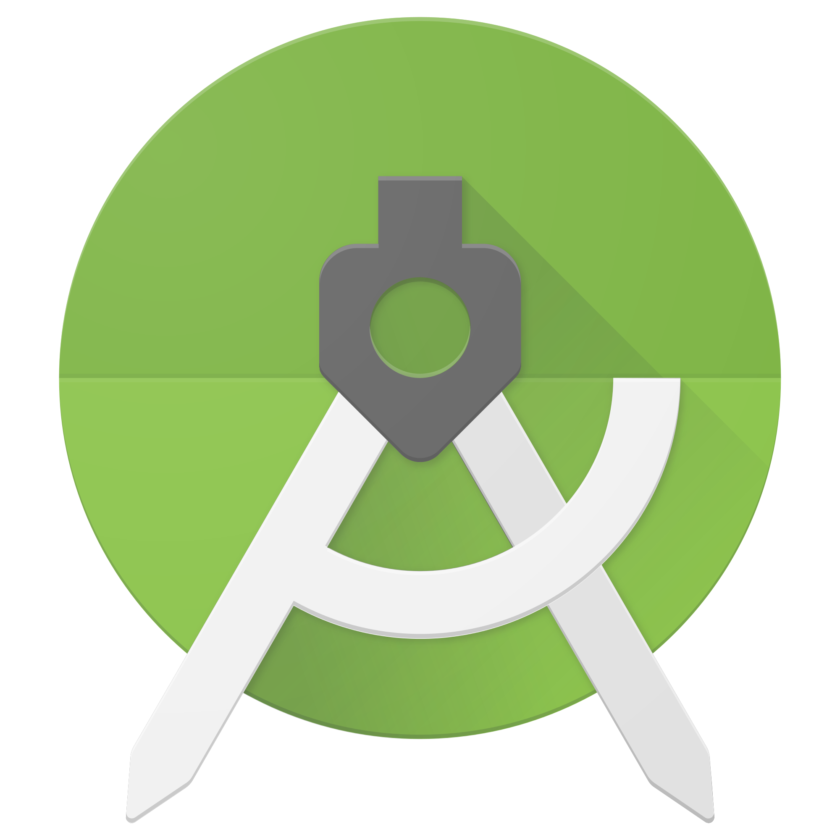

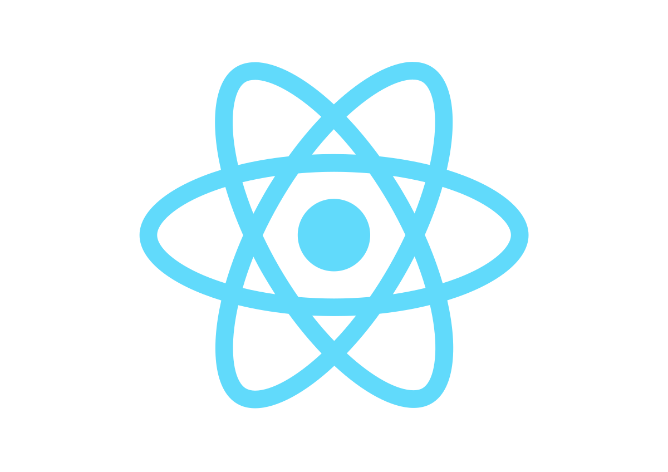
Platforms
Android Studio
IDE developed by google.
Uses Xml and Java/Kotlin programming language.
Mostly preferred by developers as it has wide community support.
Xamarin
Used to build android, IOS and windows app.
Uses C# as programming language.
React Native
React Native is UI focused platform , which makes the apps load quickly and gives a smoother feel.
It helps you create exciting mobile apps with the help of JavaScript, HTML, CSS.

Slide 4
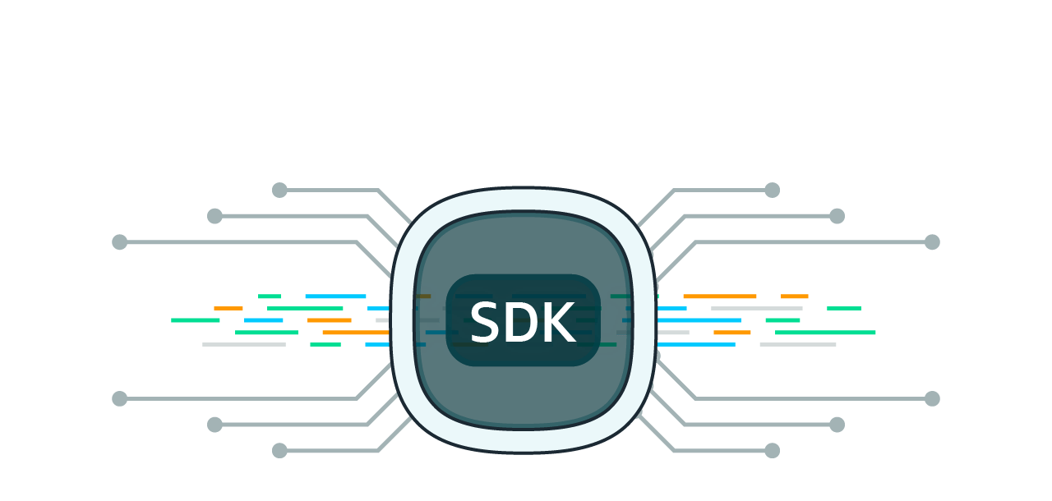
Android SDK
The Android SDK (software development kit) is a set of development tools used to develop applications for Android platform.
The Android SDK includes the following:
SDK Build-Tools is a component of the Android SDK required for building Android apps.
SDK Tools is a downloadable component for the Android SDK. It includes the complete set of development and debugging tools for the Android SDK like emulator, sdcard, sqlite and apk builder etc

Slide 5

Gradle Files
Every Android project needs a gradle for generating an apk from the .java and .xml files in the project.
In Layman terms , a gradle takes all the source files (java and XML) and apply appropriate tools, e.g., converts the java files into dex files and compresses all of them into a single file known as apk that is actually used.

Slide 6
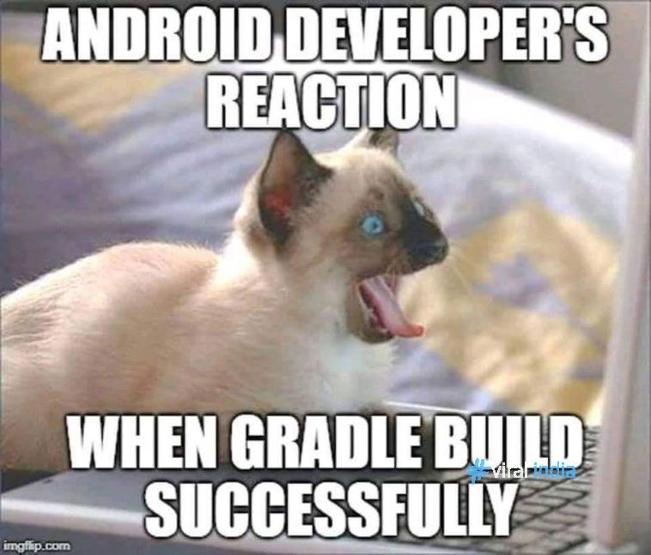

Slide 7
How To Start

Slide 8
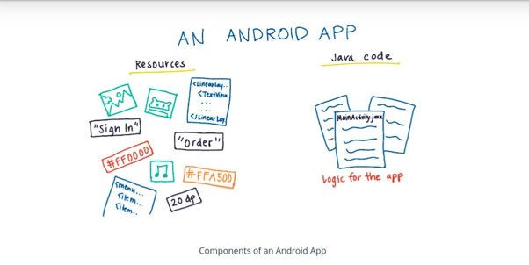

Slide 9

Become a Developer
STEP 1:
Settings > About phone > Build number.
STEP 2 :
Tap Build number seven times.
STEP 3:
Go back to Settings, where you’ll find a Developer options entry in the menu.

Slide 10
Creating Layouts
Learning XML

Slide 11
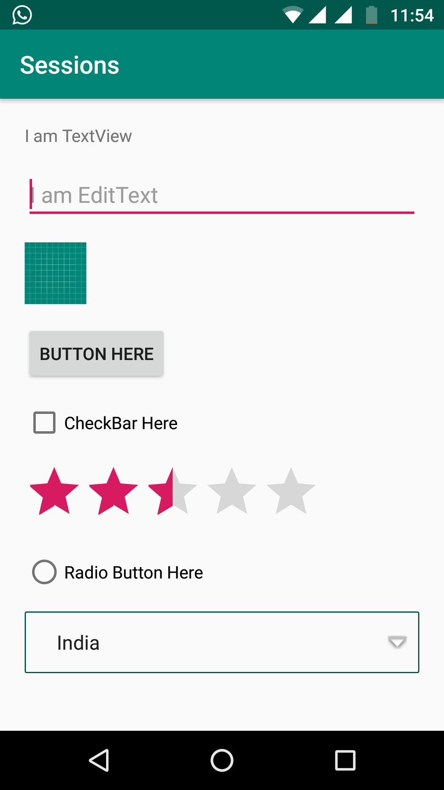
Views
TextView
EditText
ImageView
Button
Spinner
CheckBox
RatingBar
RadioButton

Slide 12
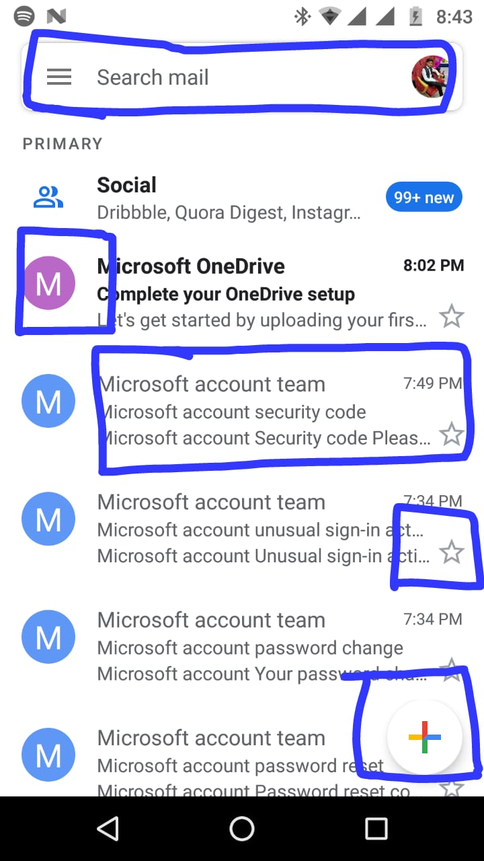
1.
2.
3.
4.
5.

Slide 13
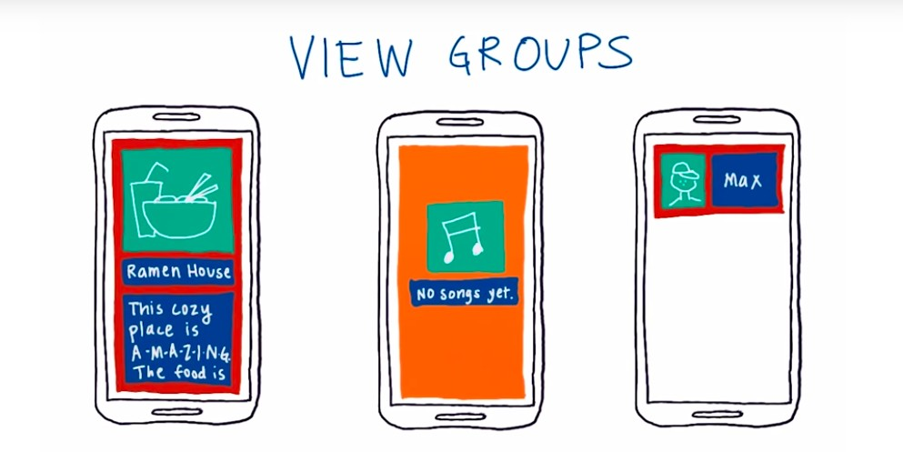

Slide 14
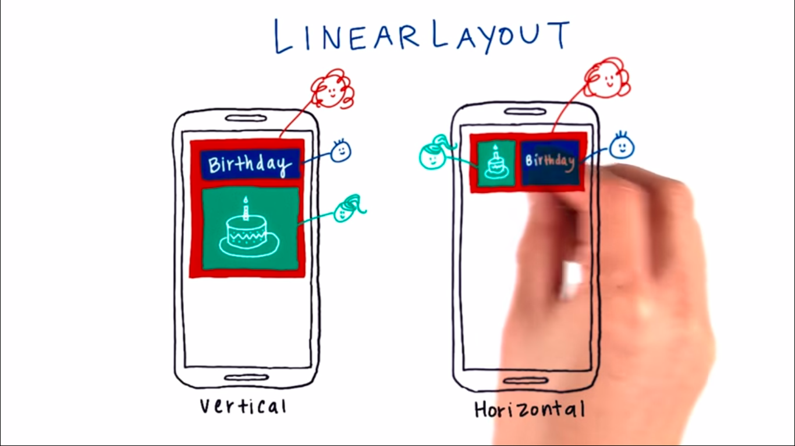

Slide 15
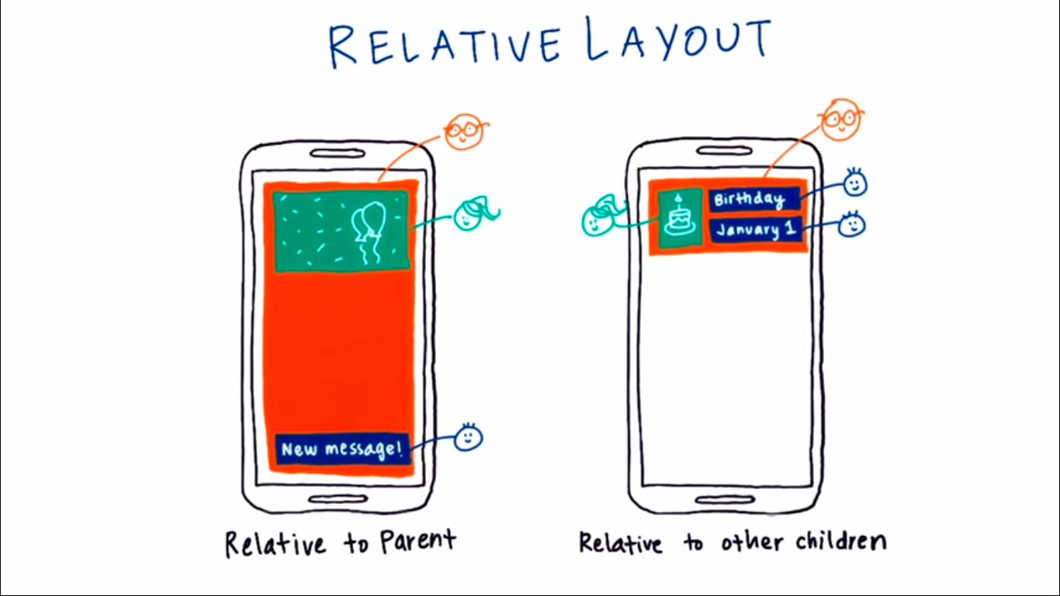

Slide 16
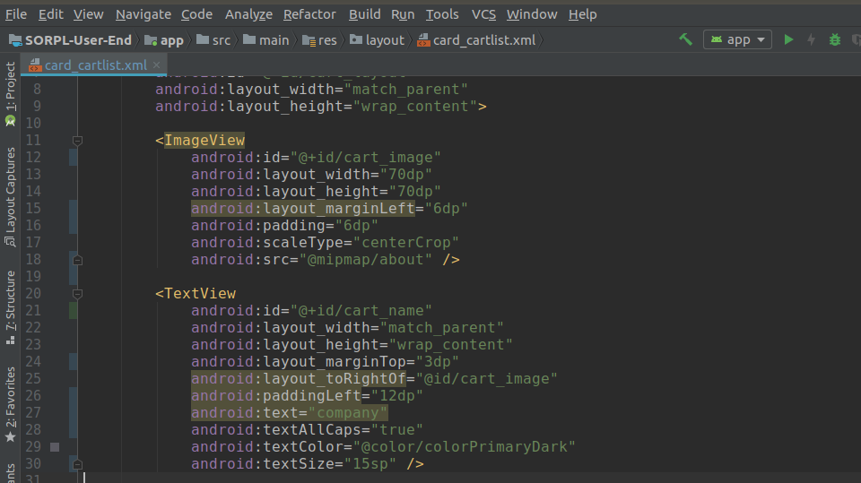
Attributes

Slide 17
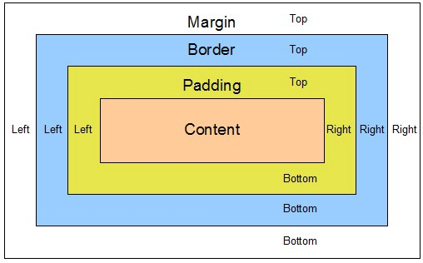
Padding vs margin

Slide 18
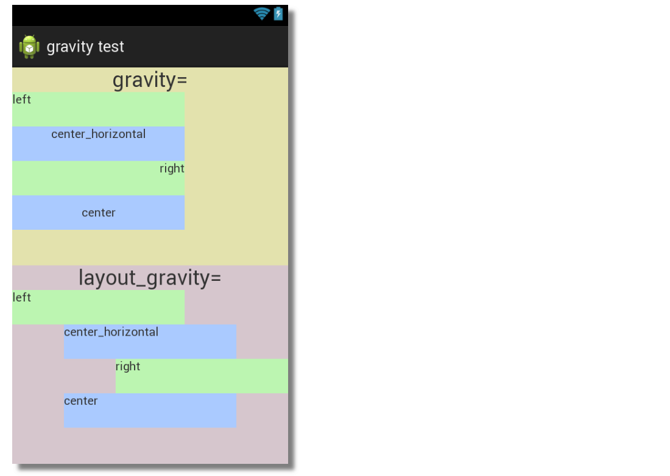
Gravity
android:gravity is used to specify how to place the content of the object within the object itself.
In another word, android:gravity is used to specify the gravity of the content of the view.
android:layout_gravity sets the gravity of the View or Layout
relative to its parent.

Slide 19
Live Coding Time ! HURRAY
Android Studio
https://labs.udacity.com/android-visualizer/

